Slide 1
Masonic Charity Pages Crawler
Kyle Elmore

Slide 2

Overview
Navigate to Masonic’s national listing page and obtain each regional page link
Navigate to each regional link and obtain all organization page links
Search through and parse out information for each organization on Masonic
Output all information found to Excel
Written in Python 3 using Selenium via Chrome

Slide 3
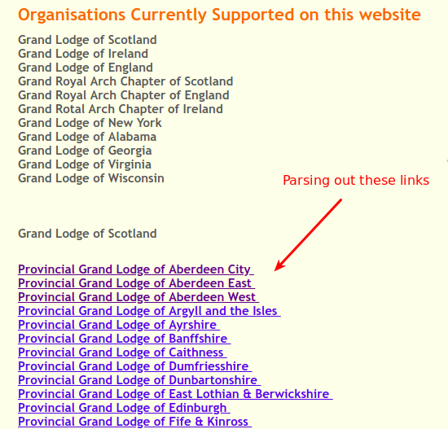
Masonic National Page
Gather all regional links from Masonic’s national page

Slide 4
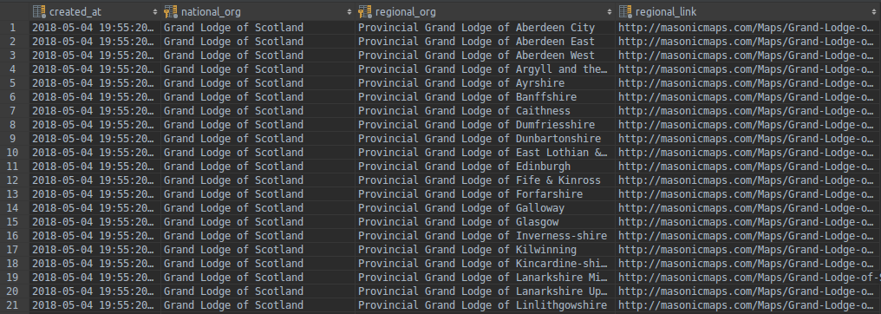
SQL Demonstration
Each link from the national page was parsed and uploaded to the database

Slide 5
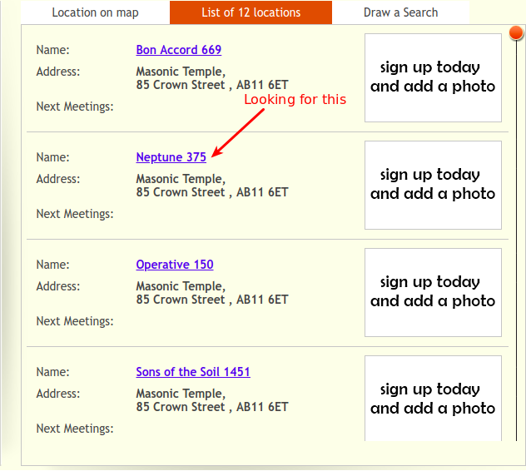
Masonic Regional Page Example
Gather all organization page links from the regional listing

Slide 6
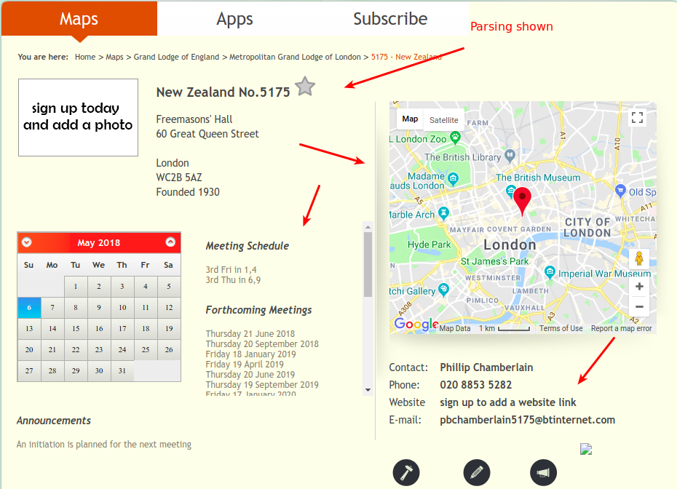
Masonic Organization Page Example
Looking for Name, Number, Address, Founded Date, Meeting Schedule, Contact Information, and Website from each organization’s page

Slide 7
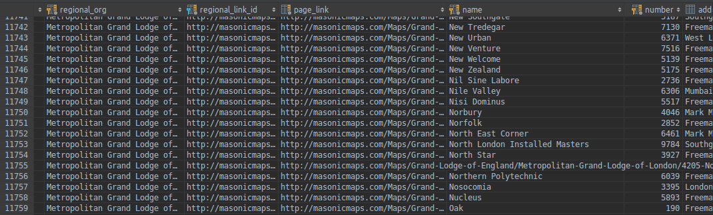
Organizations Database
All information from the organization’s page is downloaded and saved

Slide 8
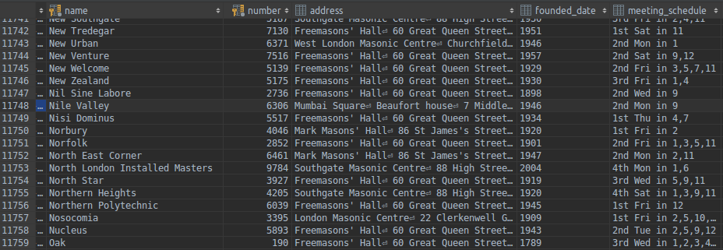
Organizations Database Continued

Slide 9
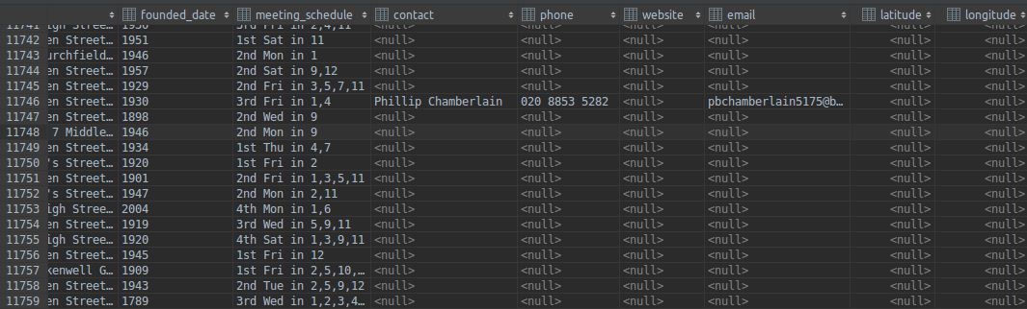
Organizations Database Continued
* Note: Most of the organization’s did not have contact information listed

Slide 10
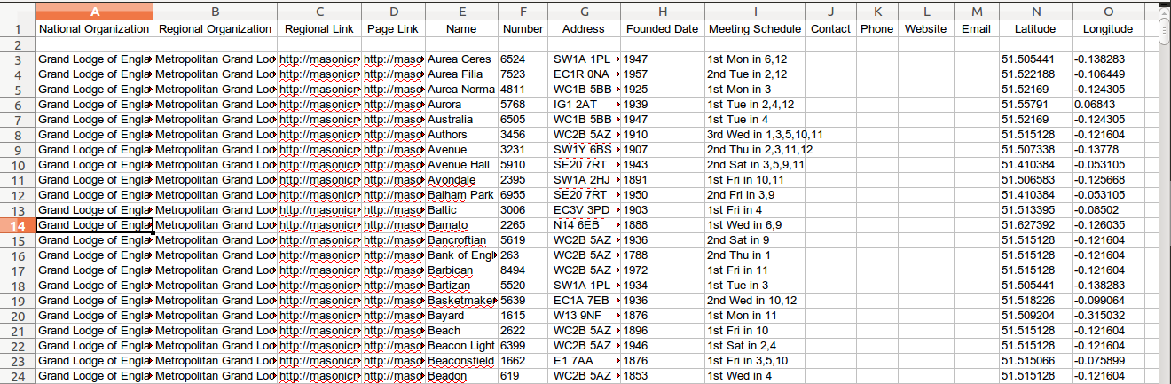
Export to Excel
All information from the organization’s page is downloaded and saved

Slide 11
Links
GitHub: https://github.com/kelmore5/masonic-web-parser
Slideshow: https://docs.google.com/presentation/d/17Cx1q3SoYaDH2dW3P5Y7aai8Q85VXepRMGrTtllWXRw/edit?usp=sharing

